Slide 1
Amy Barrett - Link to People of Praise
Study on the systematic removal of evidence connecting Amy Barrett, a SCOTUS nominee, to a religious group known as “People of Praise”
Study conducted by Udith Prabhu
CS 895
November 29, 2016

Slide 2
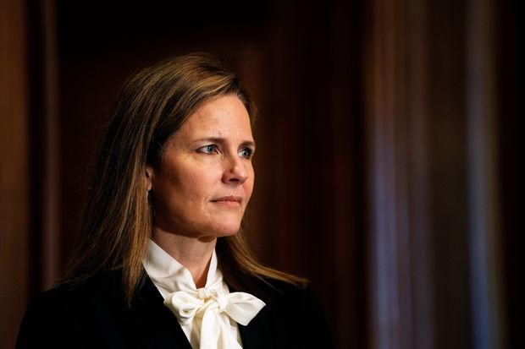
Background of Amy Barrett
Amy Barrett is currently serving as a circuit judge on the U.S. Court of Appeals for the Seventh Circuit
Was nominated for SCOTUS position on Sep 26, 2020.
Family
Spouse - Jesse M Barrett
Father - Michael E Coney
Brother - Michael Coney
Mother - Linda Coney
7 children
No official Twitter account for her or for her husband
https://en.wikipedia.org/wiki/Amy_Coney_Barrett
https://www.wsj.com/articles/supreme-court-nominee-amy-coney-barrett-signed-antiabortion-ad-in-2006-11601592289
CS895 “Amy Barrett - Link to People of Praise” a study by Udith Prabhu #cs895f20

Slide 3

People of Praise is a charismatic Christian community
Established in 1971
Is a network of lay Christian intentional communities.
1700+ members
22 branches in 17 states across the US
Web presence
Facebook - https://www.facebook.com/thevinepop
Twitter - https://twitter.com/peopleofpraise
LinkedIn - https://www.linkedin.com/company/people-of-praise-inc
Website - https://peopleofpraise.org/
https://peopleofpraise.org/
CS895 “Amy Barrett - Link to People of Praise” a study by Udith Prabhu #cs895f20

Slide 4

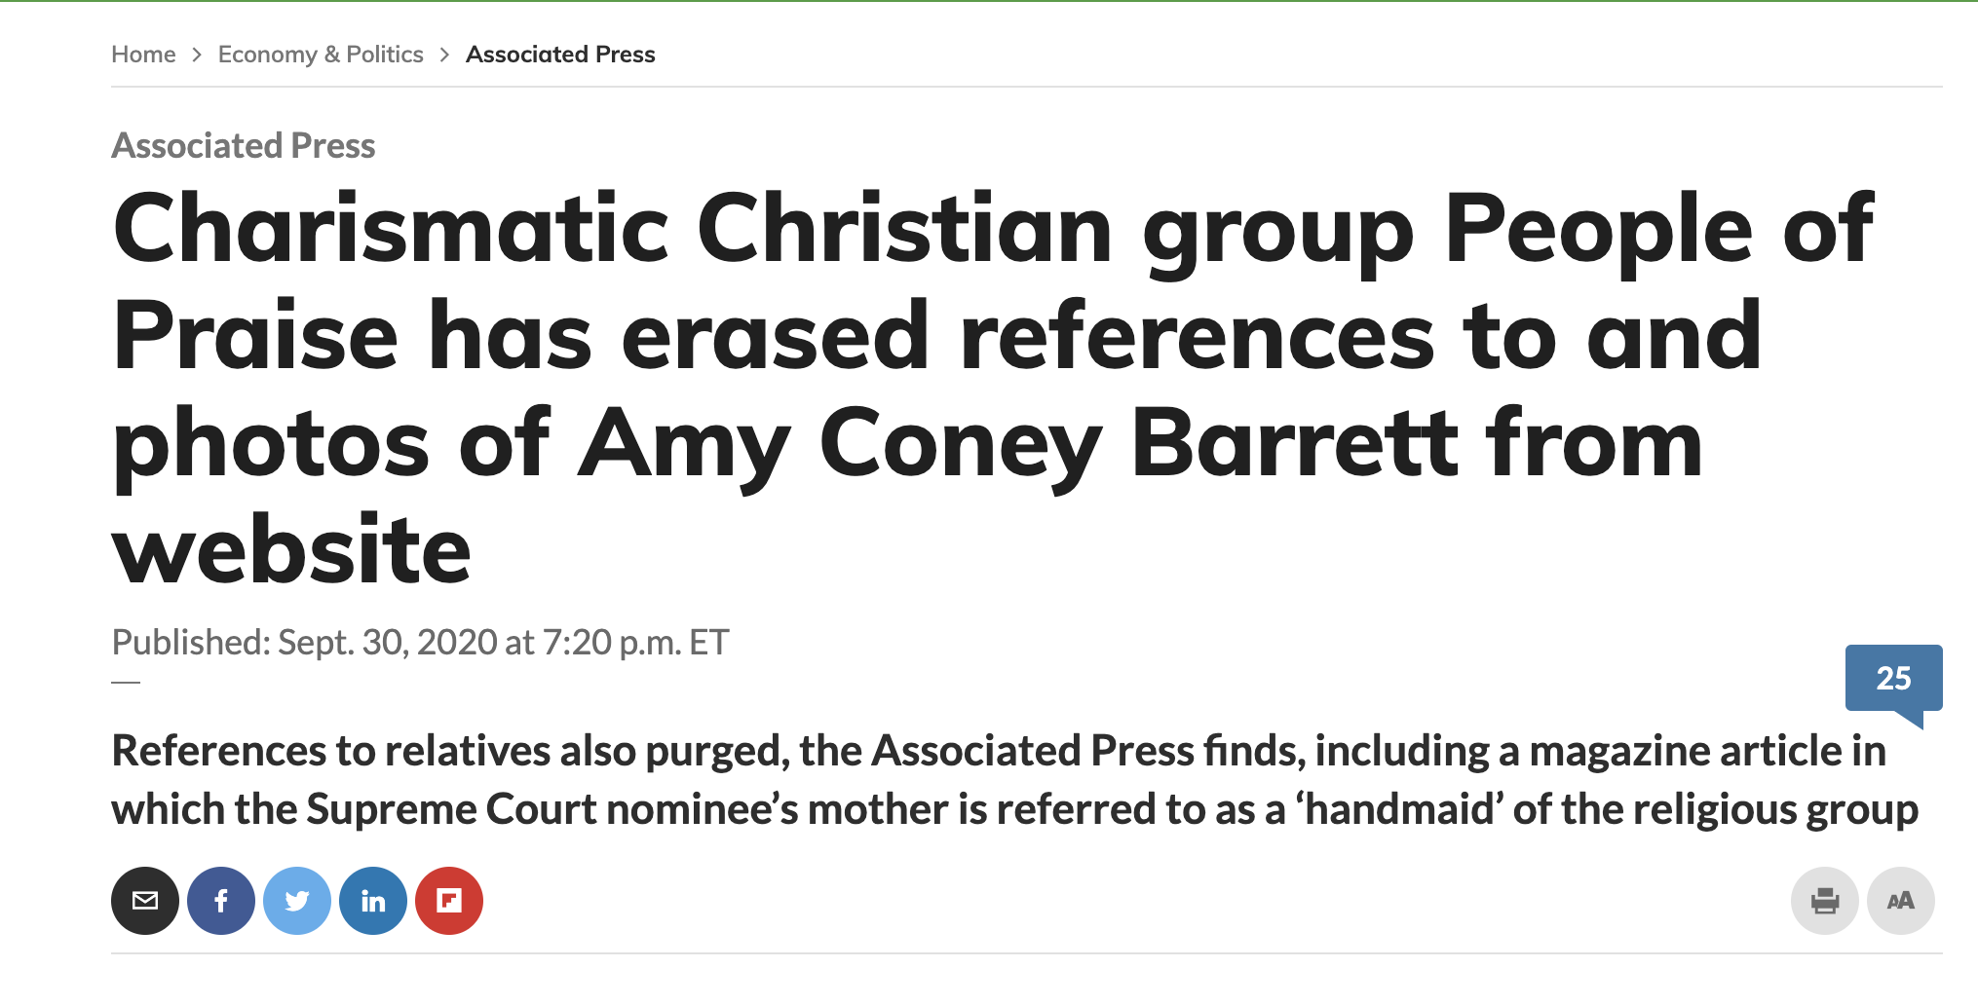
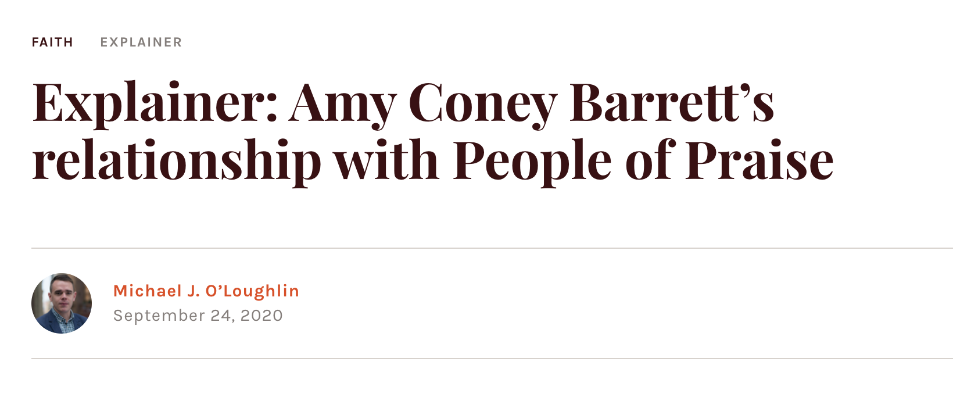
News on which the study is based on
www.southbendtribune.com/news/local/people-of-praise-deletes-mentions-of-barrett-from-its-website/article_80a427be-03eb-11eb-8d72-3bf384490a90.html
https://www.marketwatch.com/story/charismatic-christian-group-people-of-praise-has-erased-references-to-and-photos-of-amy-coney-barrett-from-website-01601508035
https://www.americamagazine.org/faith/2020/09/24/explainer-amy-coney-barrett-people-of-praise-catholic-charismatic-trump
CS895 “Amy Barrett - Link to People of Praise” a study by Udith Prabhu #cs895f20

Slide 5
First step: Twitter Analysis

Slide 6
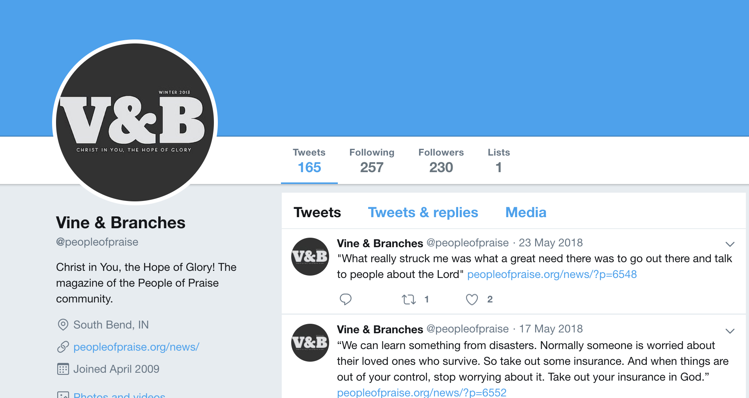

Past vs Present for the official twitter account
http://web.archive.org/web/20200920040240/https://twitter.com/peopleofpraise
https://twitter.com/peopleofpraise
CS895 “Amy Barrett - Link to People of Praise” a study by Udith Prabhu #cs895f20

Slide 7


The official Twitter account of the group and the users that are followed the group
Account was created on May 2009
0 non-deleted tweets from the account
https://twitter.com/peopleofpraise/following
https://twitter.com/meconey
CS895 “Amy Barrett - Link to People of Praise” a study by Udith Prabhu #cs895f20

Slide 8

The twitter account is most probably valid
Not a verified account of the father or the brother.
Account is followed by the official group which adds validity.
https://twitter.com/meconey/followers
CS895 “Amy Barrett - Link to People of Praise” a study by Udith Prabhu #cs895f20

Slide 9
Possible Twitter account of the father or brother not found in the archives
> carbondate https://twitter.com/meconey
{
"self": "",
"uri": "https://twitter.com/meconey",
"estimated-creation-date": "2020-10-12T00:42:03",
"earliest-sources": [
"last-modified"
],
"sources": {
"last-modified": {
"earliest": "2020-10-12T00:42:03"
},
"bing.com": {
"earliest": ""
},
"google.com": {
"earliest": ""
},
"pubdate": {
"earliest": ""
},
"twitter.com": {
"earliest": ""
},
"bitly.com": {
"earliest": ""
},
"backlinks": {
"earliest": ""
}
}
}
> memgator https://twitter.com/meconey
[ No Result ]
> curl -s "http://web.archive.org/cdx/search/cdx?url=https://twitter.com/meconey&matchType=prefix" | awk '{print $3}' | uniq;
[ No Result ]
0 non-deleted tweets from the account.
Account page was not found in any archive
None of the tweets were archived ( deleted or otherwise )
CS895 “Amy Barrett - Link to People of Praise” a study by Udith Prabhu #cs895f20

Slide 10
Finding mentions of Amy Barrett in the tweets of the account’s followers
> python3 getFollowers.py mconey > followers.txt; cat followers.txt | wc -l
17
> cat followers.txt | head -n 5
TotalNiners
peopleofpraise
joncassady
deliriousguy
_Justinw
> python3 getTweets.py followers.txt | grep "[^a-zA-Z](amy|barrett|coney)[^a-zA-Z]" | awk ‘{ print $1 }’ > mentions.txt; cat mentions.txt | wc -l
18
> cat mentions.txt | head -n 5
https://twitter.com/twitter/statuses/1314024691753979904
https://twitter.com/twitter/statuses/1310209835133276160
https://twitter.com/twitter/statuses/1016340126711140352
https://twitter.com/twitter/statuses/299544173411962880
https://twitter.com/twitter/statuses/24761693024
CS895 “Amy Barrett - Link to People of Praise” a study by Udith Prabhu #cs895f20

Slide 11
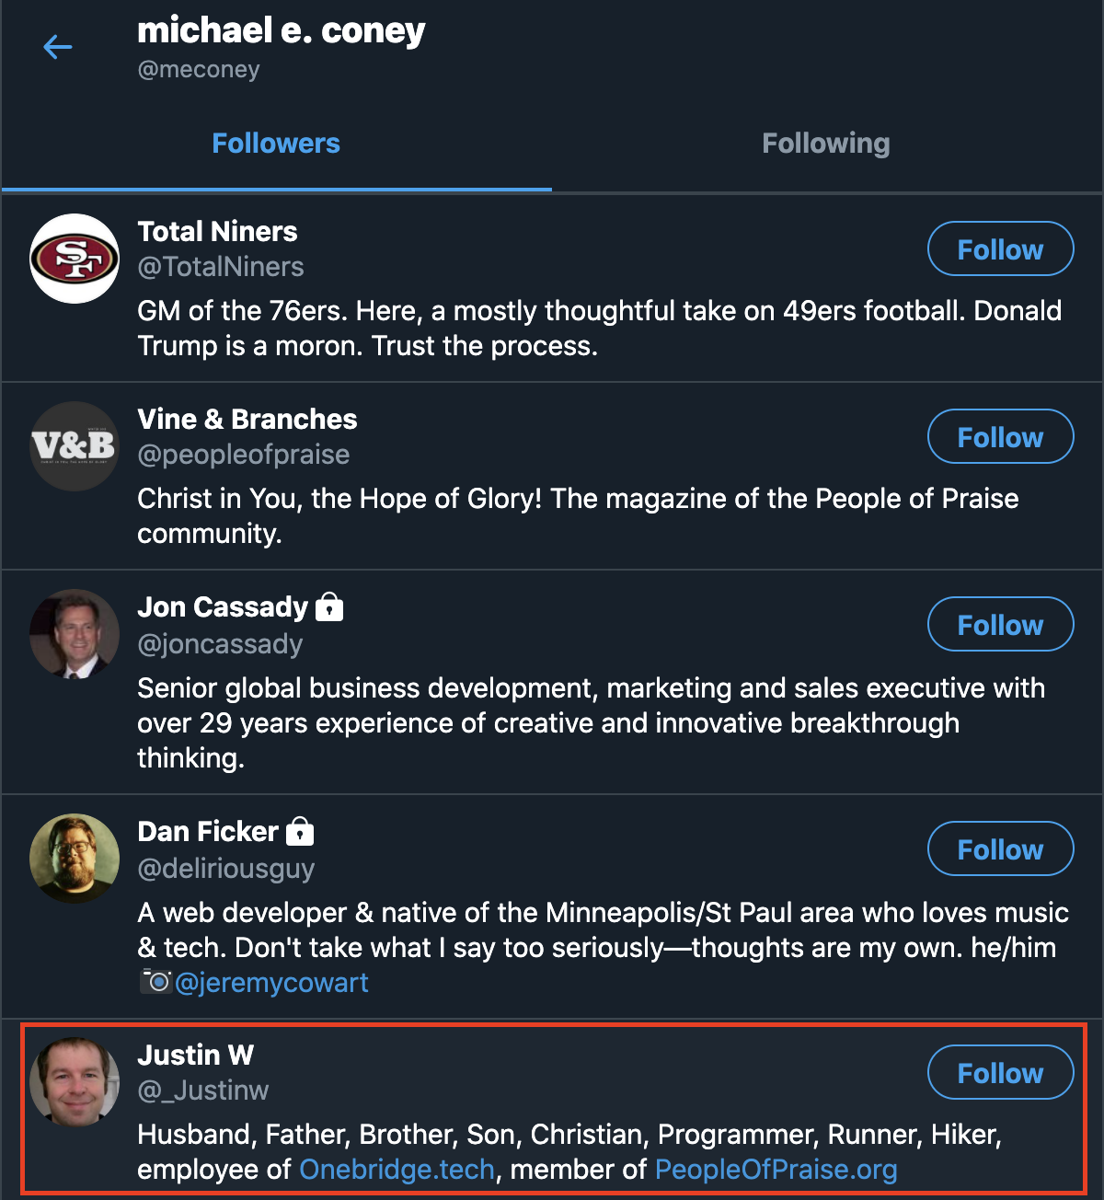
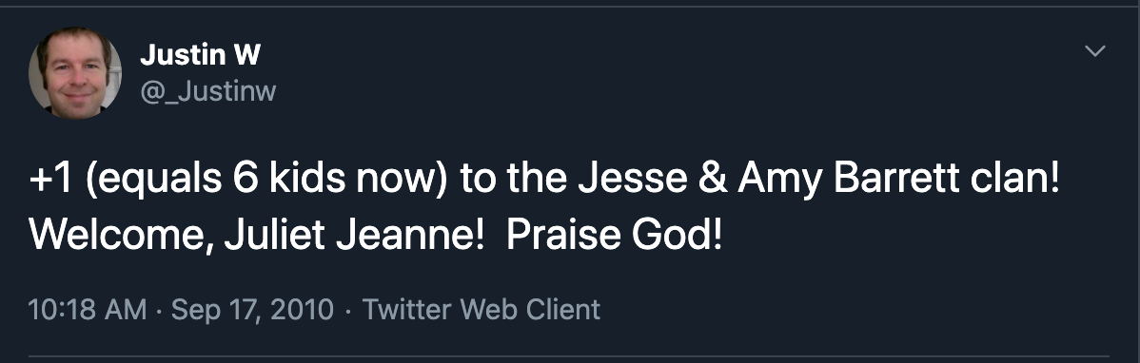

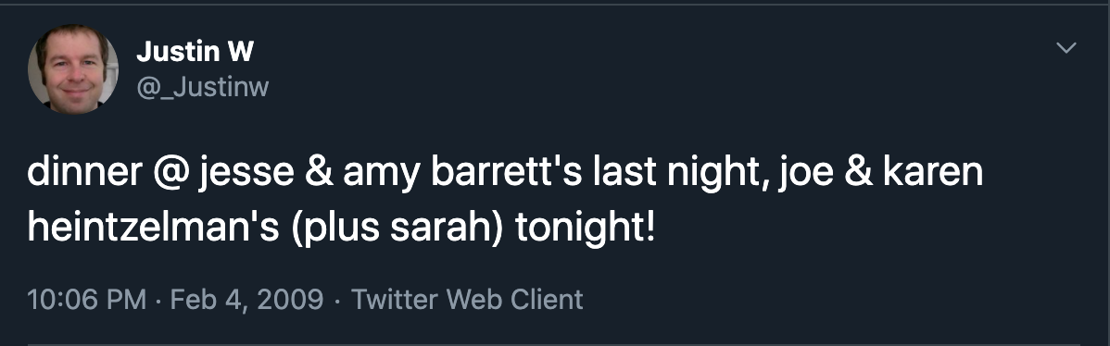
Mentions of Amy Barrett and her family in one of the group member’s tweets
https://twitter.com/_Justinw/status/24761693024
https://twitter.com/_Justinw/status/280255602
https://twitter.com/meconey
https://twitter.com/_Justinw/status/1178517639
CS895 “Amy Barrett - Link to People of Praise” a study by Udith Prabhu #cs895f20

Slide 12
Possible alternate accounts of the group
> curl -s "http://web.archive.org/cdx/search/cdx?url=https://twitter.com/peopleofpraise&matchType=prefix" | awk '{ print $2 " " $3 }' | sort | uniq
20191010042711 https://twitter.com/peopleofpraise1/status/1182147781466771457
20191101045427 https://twitter.com/peopleofpraise1/status/1190127210704846848
20200514033514 https://twitter.com/peopleofpraise2/status/1260728017401208832
20200920040227 https://twitter.com/peopleofpraise?prefetchTimestamp=1600574547226
20200920040240 https://twitter.com/peopleofpraise
20201001045721 https://twitter.com/peopleofpraise
20201007020533 https://twitter.com/peopleofpraise
Prefix search yields tweets from three different accounts
@peopleofpraise, @peopleofpraise1, @peopleofpraise2
CS895 “Amy Barrett - Link to People of Praise” a study by Udith Prabhu #cs895f20

Slide 13

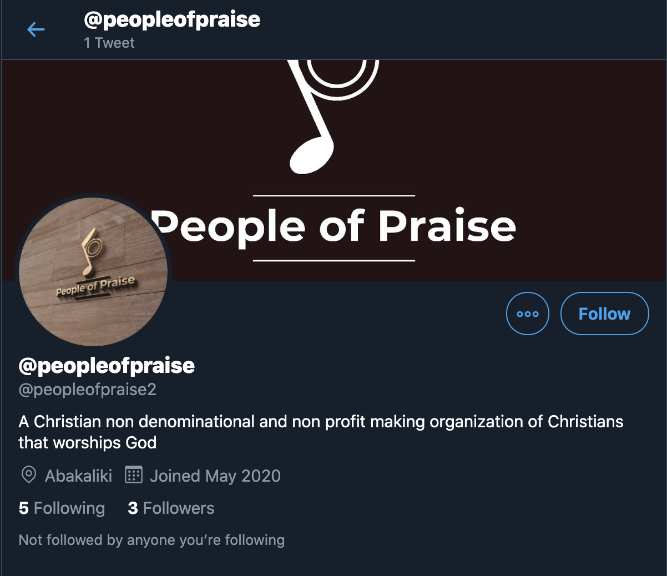
Current status of the other Twitter Accounts
Status
@peopleofpraise1 - Suspended
@peopleofpraise2 - Active
Created on
@peopleofpraise1 - Before 2019-10-10
@peopleofpraise2 - 2020-05
First Archived
@peopleofpraise1 - 2019-10-10
@peopleofpraise2 - 2020-05-14
High possibility of being fake as one account is suspended and the other has minimal account activities.
https://twitter.com/peopleofpraise1/
https://twitter.com/peopleofpraise2
CS895 “Amy Barrett - Link to People of Praise” a study by Udith Prabhu #cs895f20

Slide 14
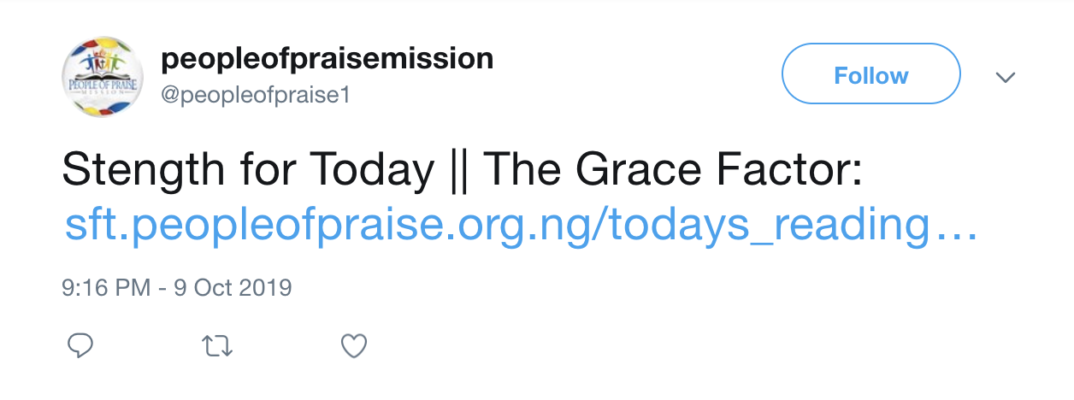
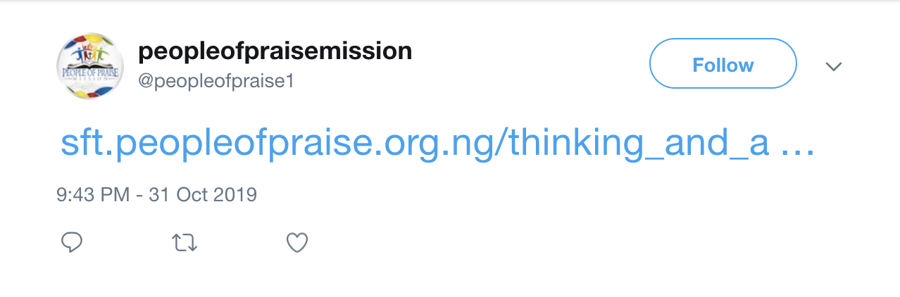
Deleted tweets of @peopleofpraise1
> curl -s "http://web.archive.org/cdx/search/cdx?url=http://twitter.com/peopleofpraise1&matchType=prefix" | awk '{print "http://web.archive.org/web/" $2 "/" $3}' | sort | uniq;
http://web.archive.org/web/20191010042711/https://twitter.com/peopleofpraise1/status/1182147781466771457
http://web.archive.org/web/20191101045427/https://twitter.com/peopleofpraise1/status/1190127210704846848
http://web.archive.org/web/20191010042711/https://twitter.com/peopleofpraise1/status/1182147781466771457
http://web.archive.org/web/20191010042711/https://twitter.com/peopleofpraise1/status/1182147781466771457
Both the tweets refer to the domain - peopleofpraise.org.ng
Possibility of a different website?
CS895 “Amy Barrett - Link to People of Praise” a study by Udith Prabhu #cs895f20

Slide 15
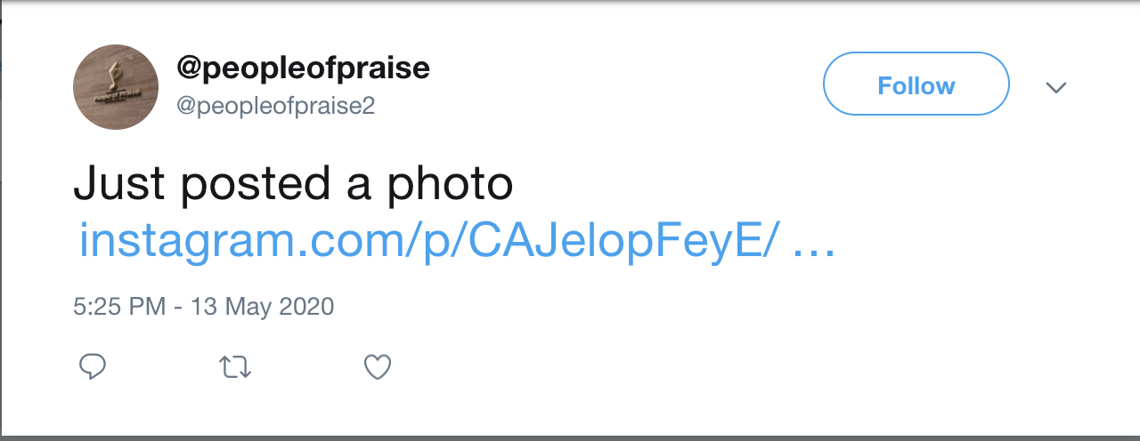
A single tweet from @peopleofpraise2
https://twitter.com/peopleofpraise2/status/1260728017401208832
https://t.co/4iPQHY8txS
CS895 “Amy Barrett - Link to People of Praise” a study by Udith Prabhu #cs895f20

Slide 16
Following the redirect link
curl -sSL -D - https://t.co/4iPQHY8txS -o /dev/null
HTTP/2 301
cache-control: private,max-age=300
content-length: 0
date: Thu, 15 Oct 2020 15:22:57 GMT
expires: Thu, 15 Oct 2020 15:27:57 GMT
location: https://www.instagram.com/p/CAJelopFeyE/?igshid=rgx1vk8rbm74
server: tsa_b
set-cookie: muc=b1dd6b4e-e8f7-43d6-a45b-07d65b33849f; Max-Age=63072000; Expires=Sat, 15 Oct 2022 15:22:57 GMT; Domain=t.co; Secure; SameSite=None
vary: Origin
x-connection-hash: b6b4382b4403bd41038b9db3a341369a
x-response-time: 9
HTTP/2 404
content-type: text/html; charset=utf-8
vary: Cookie, Accept-Language
content-language: en
date: Thu, 15 Oct 2020 15:22:57 GMT
strict-transport-security: max-age=31536000
cache-control: private, no-cache, no-store, must-revalidate
pragma: no-cache
expires: Sat, 01 Jan 2000 00:00:00 GMT
x-frame-options: SAMEORIGIN
content-length: 45956
x-fb-trip-id: 1679558926
alt-svc: h3-29=":443"; ma=3600,h3-27=":443"; ma=3600
CS895 “Amy Barrett - Link to People of Praise” a study by Udith Prabhu #cs895f20

Slide 17
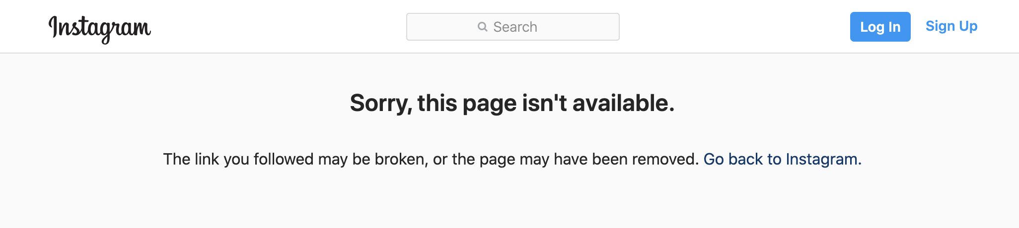
The Instagram page is not present in the archives
> curl -iLs memgator.cs.odu.edu/timemap/link/https://www.instagram.com/p/CAJelopFeyE
HTTP/1.1 404 Not Found
Access-Control-Allow-Origin: *
Access-Control-Expose-Headers: Link, Location, X-Memento-Count, Server
Content-Length: 19
Content-Type: text/plain; charset=utf-8
Date: Thu, 15 Oct 2020 00:55:29 GMT
Server: MemGator/1.0-rc8
X-Content-Type-Options: nosniff
X-Memento-Count: 0
404 page not found
https://www.instagram.com/p/CAJelopFeyE/?igshid=rgx1vk8rbm74
The Instagram post is neither present in archives nor is it present on the live web
CS895 “Amy Barrett - Link to People of Praise” a study by Udith Prabhu #cs895f20

Slide 18
Finding archived copies of the alternate link found in tweets from @peopleofpraise1
> curl http://www.peopleofpraise.org.ng
curl: (6) Could not resolve host: www.peopleofpraise.org.ng
> memgator http://www.peopleofpraise.org.ng
[ No Result ]
> curl -s "http://web.archive.org/cdx/search/cdx?url=http://www.peopleofpraise.org.ng&matchType=prefix" | awk '{print "http://web.archive.org/" $2 "/" $3}' | uniq;
[ No Result ]
> curl -s "http://web.archive.org/cdx/search/cdx?url=peopleofpraise.org.ng&matchType=host" | awk '{print "http://web.archive.org/" $2 "/" $3}' | uniq;
[ No Result ]
> curl -s "http://web.archive.org/cdx/search/cdx?url=peopleofpraise.org.ng&matchType=domain" | awk '{print "http://web.archive.org/" $2 "/" $3}' | uniq;
[ No Result ]
No links from the org.ng extension was archived by the Wayback Machine
CS895 “Amy Barrett - Link to People of Praise” a study by Udith Prabhu #cs895f20

Slide 19
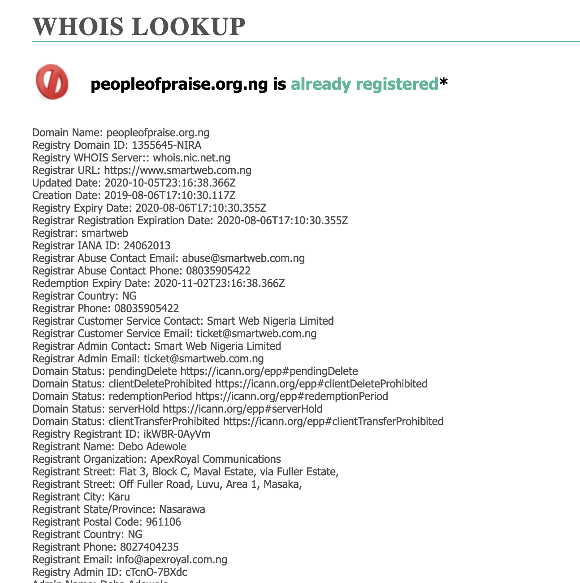
The website was registered before the tweet
Tweet date - Oct 9th 2019
Domain registration date - Aug 6th 2019
The domain was valid at the time of the tweet
CS895 “Amy Barrett - Link to People of Praise” a study by Udith Prabhu #cs895f20

Slide 20
Second step: Website Analysis

Slide 21
IA and BA have the most number of mementos of the group’s homepage
> curl -s http://memgator.cs.odu.edu/timemap/link/https://peopleofpraise.org/ | grep datetime | awk '{print $1}' | awk -v FS=/ '{print $3}' | sort | uniq -c | sort -n -r
367 web.archive.org
93 web.archive.bibalex.org:80
2 wayback.archive-it.org
2 arquivo.pt
2 archive.md
CS895 “Amy Barrett - Link to People of Praise” a study by Udith Prabhu #cs895f20

Slide 22
1803 distinct web pages of the website found in the IA
> curl -s "http://web.archive.org/cdx/search/cdx?url=https://peopleofpraise.org/&matchType=prefix" | awk '{ print $3 }' > urls.txt; python3 sanitize.py urls.txt | sort | uniq > distinct.txt
> cat distinct.txt | wc -l
1803
> cat distinct.txt | head -n 5
http://www.peopleofpraise.org/news/6.0.65
http://www.peopleofpraise.org/news/?feed=rss2&p=233
http://www.peopleofpraise.org/missionary/?cat=11
http://www.peopleofpraise.org/media/main/vb/add/V%26B%20Summer%202015%20web.pdf
http://www.peopleofpraise.org/thevine/covers/2011-wintercover.jpg
CS895 “Amy Barrett - Link to People of Praise ” a study by Udith Prabhu #cs895f20

Slide 23
1502 web pages archived with 200 status
> curl -s "http://web.archive.org/cdx/search/cdx?url=https://peopleofpraise.org/&matchType=prefix" | awk '{ if($2 == 200) {print $3} }' > valid.txt; python3 sanitize.py valid.txt | sort | uniq > valid_distinct.txt
> cat valid_distinct.txt | wc -l
1502
> cat valid_distinct.txt | head -n 5
http://www.peopleofpraise.org/news/wp-content/themes/gridline_lite/js/functions.js
http://www.peopleofpraise.org/news/wp-content/uploads/2017/01/32451680115_131ca35497_o-1200x800.jpg
http://www.peopleofpraise.org/news/wp-content/uploads/2010/03/Evansville-map1.jpg
http://www.peopleofpraise.org/news/wp-content/uploads/2014/09/Episode-1-image-1024x576.jpg
http://www.peopleofpraise.org/media/thevine/2008-10-11-vine-and-branches.pdf
1502 out of the 1803 archived web pages were archived successfully
( 200 during capture )
CS895 “Amy Barrett - Link to People of Praise ” a study by Udith Prabhu #cs895f20

Slide 24
54 pages of the website found in the BA Archive
> curl -s "http://web.archive.bibalex.org/web/*/http://www.peopleofpraise.org*" | grep -Eo '\"([^\"]*?web.archive.bibalex.*peopleofpraise[^\"]*?)\"' | grep -v query | sed 's:^.\(.*\).$:\1:' | cut -d/ -f 6- | sort | uniq > ba.txt
> cat ba.txt | wc -l
54
> cat ba.txt | head -n 5
http://peopleofpraise.org/pics/moretrinsm.gif
http://peopleofpraise.org/pics/revival.gif
http://peopleofpraise.org/pics/transparent.gif
http://www.peopleofpraise.org/feedback
http://www.peopleofpraise.org/misc/drupal.css
> cat ba.txt >> valid_distinct.txt
CS895 “Amy Barrett - Link to People of Praise ” a study by Udith Prabhu #cs895f20

Slide 25
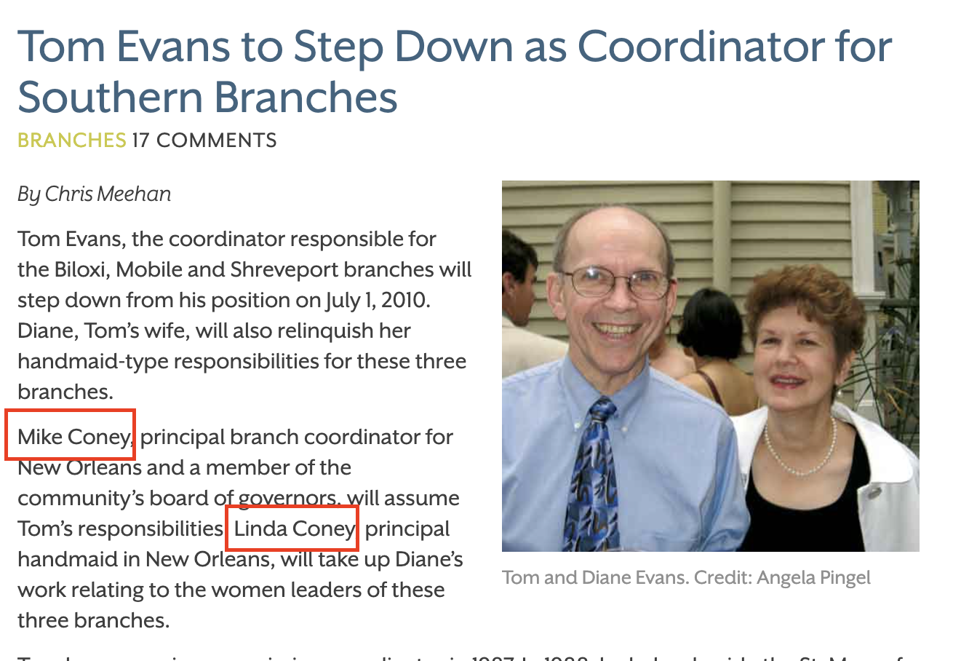
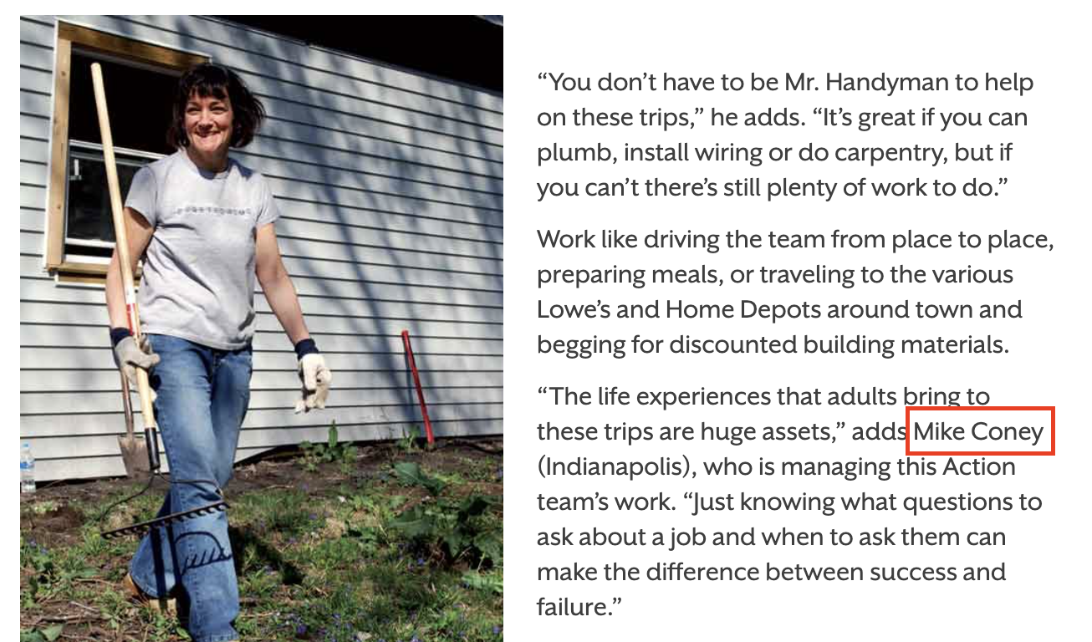
45 live web pages of the group contain the word “Amy”, “Barrett” or “Coney”
> python3 matchWebContent.py valid_distinct.txt > matched.txt; cat matched.txt | wc -l
45
> cat matched.txt | head -n 2
http://www.peopleofpraise.org/news/?p=566 coney
http://www.peopleofpraise.org/news/?p=284 coney
http://www.peopleofpraise.org/news/?p=566
https://peopleofpraise.org/news/?p=284
CS895 “Amy Barrett - Link to People of Praise ” a study by Udith Prabhu #cs895f20

Slide 26
0 references of Amy Barrett on the live website
Person | Relationship | Count of References
Amy Coney Barrett | Self | 0
Jesse Barrett | Husband | 0
Michael Coney or Michael E Coney | Father or Brother | 13
Linda Coney | Mother | 13
Table was generated after manually verifying the various links that had one of the keyword “Amy”, “Coney” or “Barrett”
CS895 “Amy Barrett - Link to People of Praise ” a study by Udith Prabhu #cs895f20

Slide 27
Successfully Archived pages that are currently unavailable
> python3 checkInactive.py valid_distinct.txt > inactive.txt; cat inactive.txt | wc -l
484
> cat inactive.txt | head -n 5
http://www.peopleofpraise.org/news/wp-content/themes/gridline_lite/js/functions.js
http://www.peopleofpraise.org/media/thevine/2008-10-11-vine-and-branches.pdf
http://www.peopleofpraise.org/pdfsize/pdf/V&B%20Winter%202018%20web.pdf.300x.jpg
http://www.peopleofpraise.org/thevine/issues/2008-05-vine-and-branches.pdf
http://www.peopleofpraise.org/media/index.js
> cat inactive.txt | grep -v “(jpg|png|gif|js|css)/?$” > final.txt; cat final.txt | wc -l
289
> cat final.txt | head -n 5
http://www.peopleofpraise.org/media/thevine/2008-10-11-vine-and-branches.pdf
http://www.peopleofpraise.org/news/?cat=30
http://www.peopleofpraise.org/thevine/issues/2008-05-vine-and-branches.pdf
http://www.peopleofpraise.org/news/?cat=19
http://www.peopleofpraise.org/news/?p=5454
CS895 “Amy Barrett - Link to People of Praise ” a study by Udith Prabhu #cs895f20

Slide 28
7 references to Amy Barrett found in archived pages
> cat inactive.py | grep pdf > pdf.txt; cat pdf.txt | wc -l
102
> cat pdf.txt | head -n 2
http://web.archive.org/web/20151018030811id_/http://peopleofpraise.org/media/thevine/2011-winter-vine-and-branches.pdf
http://web.archive.org/web/20151018031423id_/http://peopleofpraise.org/media/thevine/2012-summer-vine-and-branches.pdf
Person | Relationship | Count of References
Amy Coney Barrett | Self | 7
Jesse Barrett | Husband | 6
Michael Coney or Michael E Coney | Father or Brother | 36
Linda Coney | Mother | 9
Table was generated after manually verifying the archived content for keywords “Amy”, “Coney” or “Barrett”
CS895 “Amy Barrett - Link to People of Praise ” a study by Udith Prabhu #cs895f20

Slide 29
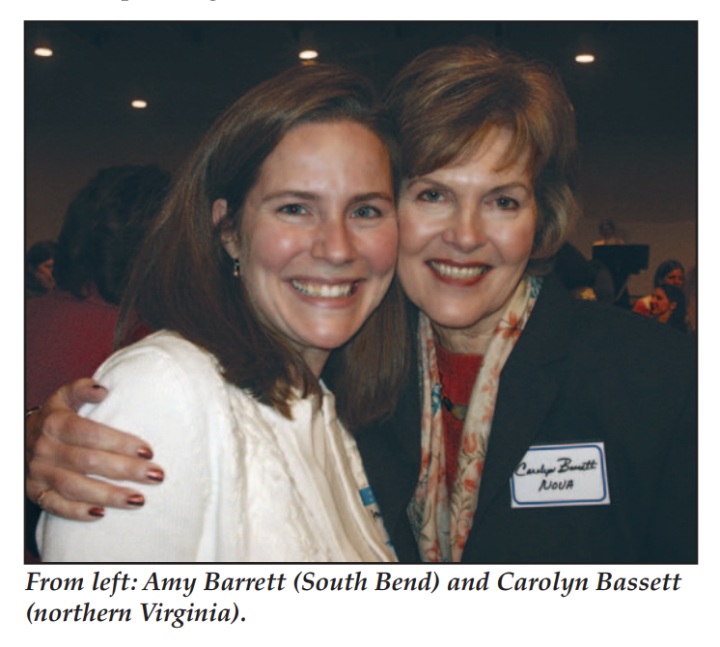
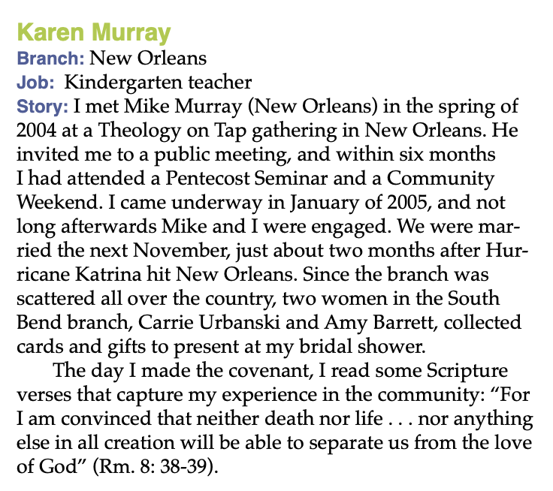
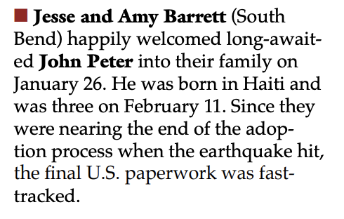
Image snippet of 3 of the 7 references
http://web.archive.org/web/20151018015716id_/http://peopleofpraise.org/media/thevine/2010-03-vine-and-branches.pdf
http://web.archive.org/web/20151018072823id_/http://peopleofpraise.org/media/thevine/2008-12-vine-and-branches.pdf
http://web.archive.org/web/20071028065558id_/http://www.peopleofpraise.org/thevine/issues/2006-05-vine-and-branches.pdf
CS895 “Amy Barrett - Link to People of Praise ” a study by Udith Prabhu #cs895f20

Slide 30
Summary
Amy Barrett and her husband do not have an official Twitter account, so any analysis on their tweets could not be conducted.
The group’s official twitter account is not famous enough to be archived frequently, so deleted tweets, if any, were not found.
No mention of Amy Barrett or her husband Jessie Barrett was found on the live version of the group’s website.
Seven references to Amy Barrett and six references to Jessie Barrett were found to be deleted from the website.
All the digital magazines were removed from the website. This could have been done to obfuscate the intent of only removing references to Amy Barrett.
CS895 “Amy Barrett - Link to People of Praise ” a study by Udith Prabhu #cs895f20

Slide 31
Backup Slides

Slide 32
Script for getting the followers of a twitter account
import tweepy
import sys
consumer_key = "*"
consumer_secret = "*"
access_token = "*"
access_token_secret = "*"
auth = tweepy.OAuthHandler(consumer_key, consumer_secret)
auth.set_access_token(access_token, access_token_secret)
api = tweepy.API(auth)
for page in tweepy.Cursor(api.followers, screen_name=sys.argv[1]).pages():
for user in [x.screen_name for x in page]:
print(user)
CS895 “Amy Barrett - Link to People of Praise ” a study by Udith Prabhu #cs895f20

Slide 33
Script for getting the tweets of a twitter account
import tweepy
import sys
consumer_key = "*"
consumer_secret = "*"
access_token = "*"
access_token_secret = "*"
auth = tweepy.OAuthHandler(consumer_key, consumer_secret)
auth.set_access_token(access_token, access_token_secret)
api = tweepy.API(auth)
with open(sys.argv[1], “r”) as f:
for user in f.read().split(“\n”):
for tweet in tweepy.Cursor(api.user_timeline,id=user, tweet_mode = "extended").items():
print(f"https://twitter.com/twitter/statuses/{tweet.id} {tweet.full_text}")
CS895 “Amy Barrett - Link to People of Praise ” a study by Udith Prabhu #cs895f20

Slide 34
Script for sanitizing the url
import sys
fname = sys.argv[1]
with open(fname, “r”) as f:
for url in f.read().split(“\n”):
print("http://www." + url.split("//", 1)[-1].lstrip("www.").rstrip("/").replace(“:80”, “”))
CS895 “Amy Barrett - Link to People of Praise ” a study by Udith Prabhu #cs895f20

Slide 35
Script for keyword search in set of live urls
import sys
import re
import requests
pattern = pattern = re.compile(r"[^a-zA-Z](amy|barrett|coney)[^a-zA-Z]", re.IGNORECASE)
fname = sys.argv[1]
with open(fname, “r”) as f:
for url in f.read().split(“\n”):
resp = requests.get(url)
if “html” in resp.headers[“Content-Type”] and pattern.search(resp.content.decode(“urf-8”):
print(url)
CS895 “Amy Barrett - Link to People of Praise ” a study by Udith Prabhu #cs895f20

Slide 36
Script for checking inactive urls
import sys
import requests
def sanitize(x):
return "http://www." + x.replace(":80", "").replace("https", "http").split("/", 2)[-1].replace("www.", "")
fname = sys.argv[1]
with open(fname, “r”) as f:
for url in f.read().split(“\n”):
resp = requests.get(url)
status_code = resp.status_code
if sanitize(resp.url) != sanitize(url):
status_code = resp.history[0].status_code if len(resp.history) > 0 else status_code
if status_code != 200:
print(url)
CS895 “Amy Barrett - Link to People of Praise ” a study by Udith Prabhu #cs895f20

